Slide 1
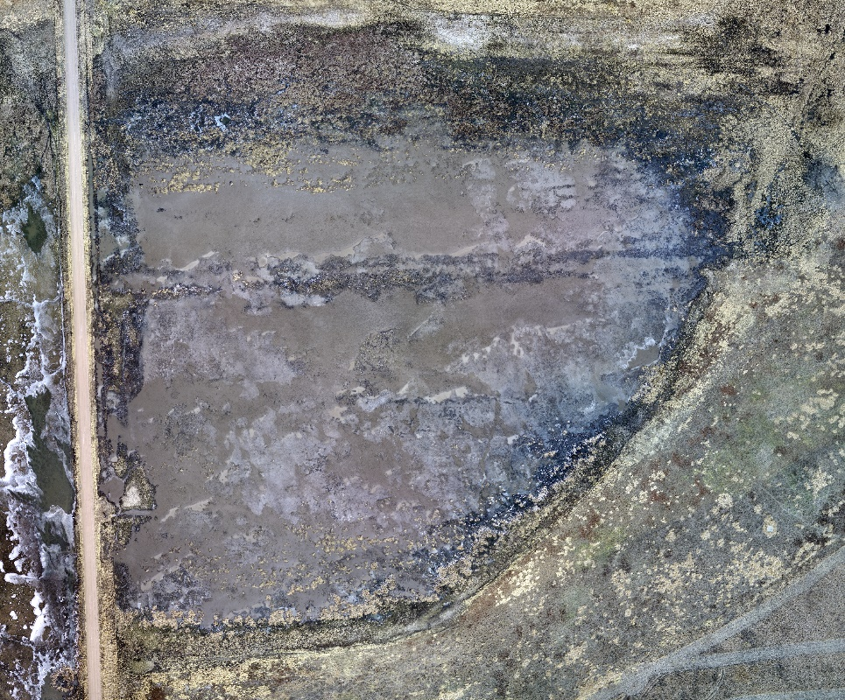
Final Project
UAV Imagery based Wetland Land Cover Classification
Qiao Hu, SNR, UNL
Paul Fletcher, CSE, UNL
Jacob Gideon,CSE, UNL
Paul O’Dell, CSE, UNL
April 22, 2021

Slide 2

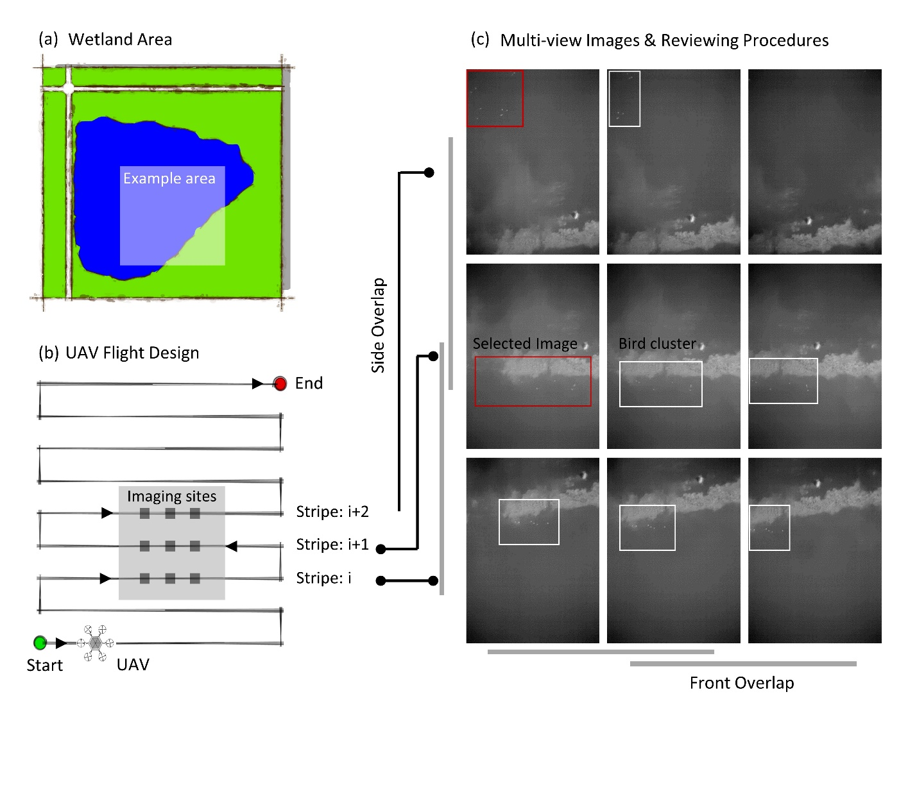

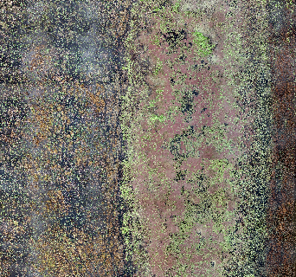
Data & Goals
Location: Straightwater WMA, 03/08/2018
RGB Reference
Example Area
Goal: Develop machine learning method to automatically delineate wetland area based on UAV multispectral data.
Multispectral Imagery
Blue; Green; Red; Rededge; NIR;
Resolution: 9.3 cm
Notes:
The data is unique because it is a very high resolution and multispectral… Not only were the UAVs collecting data based on

Slide 3

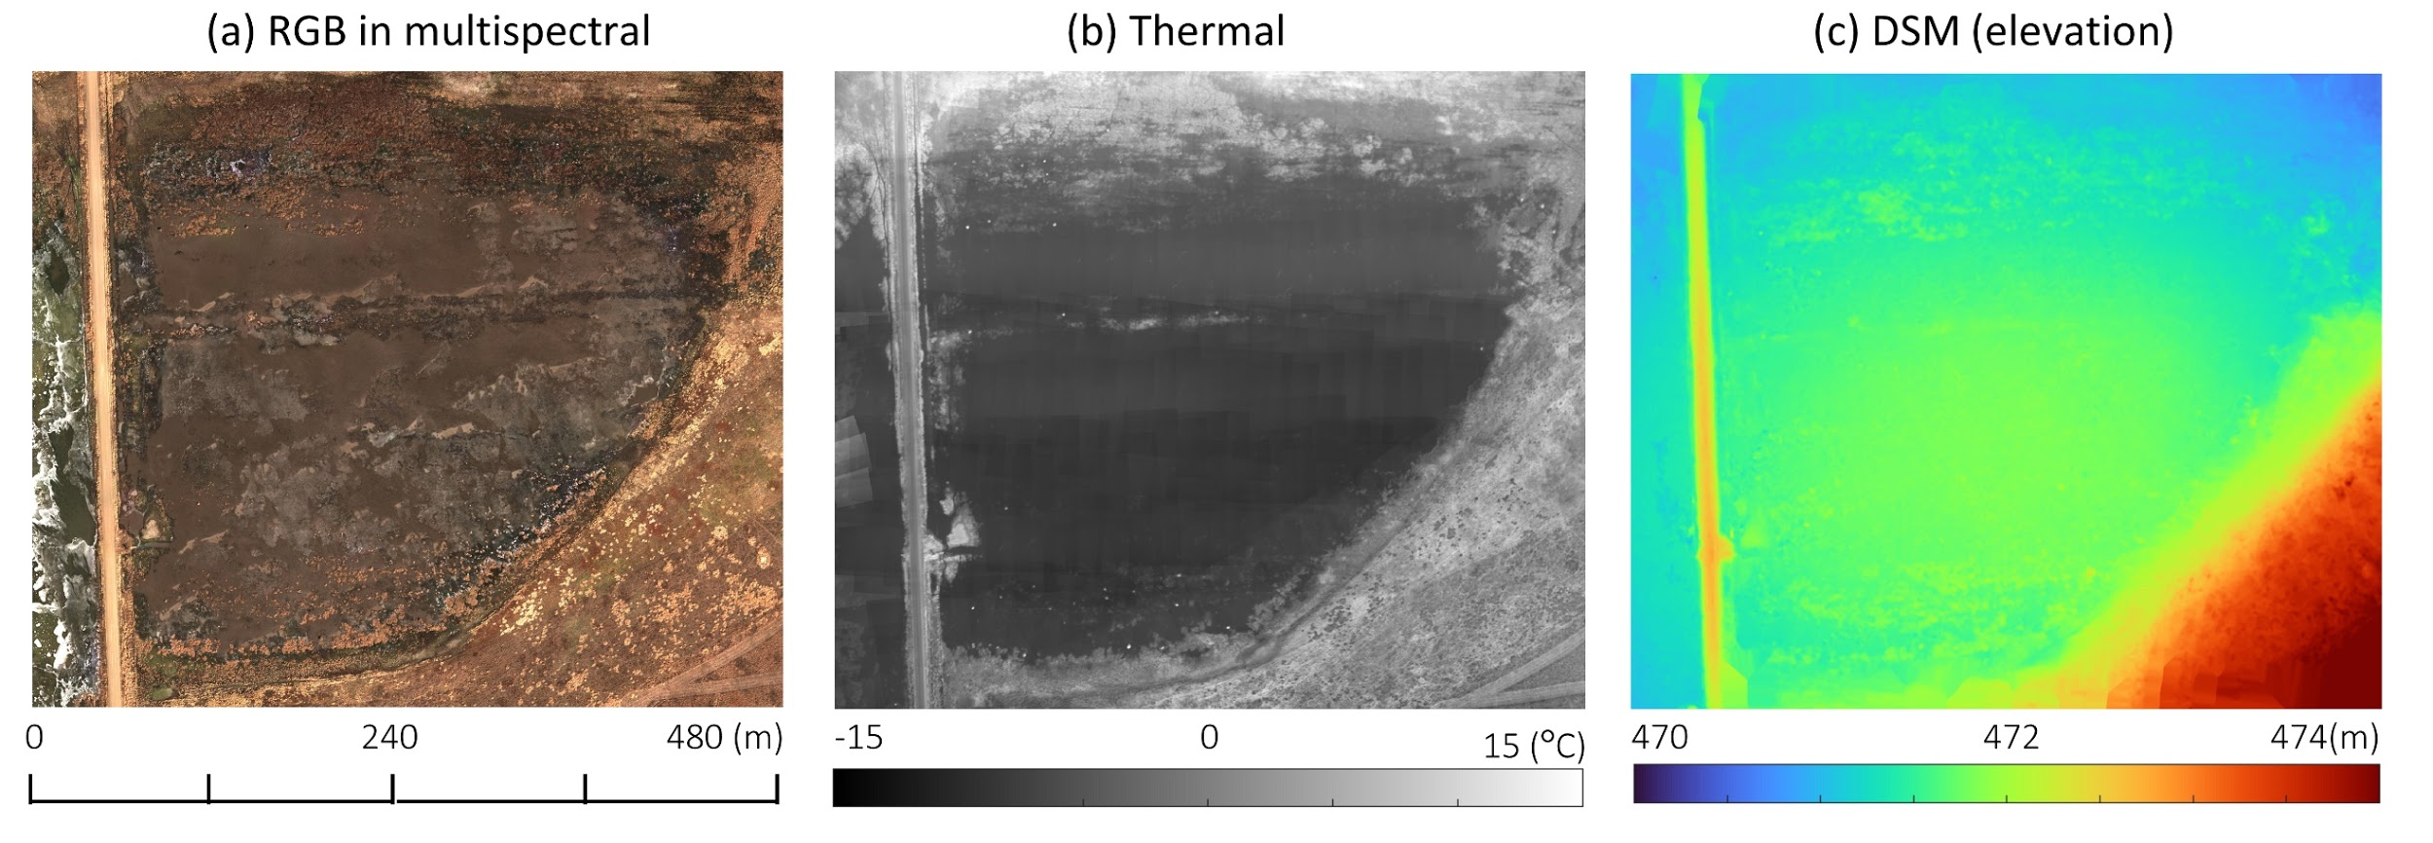
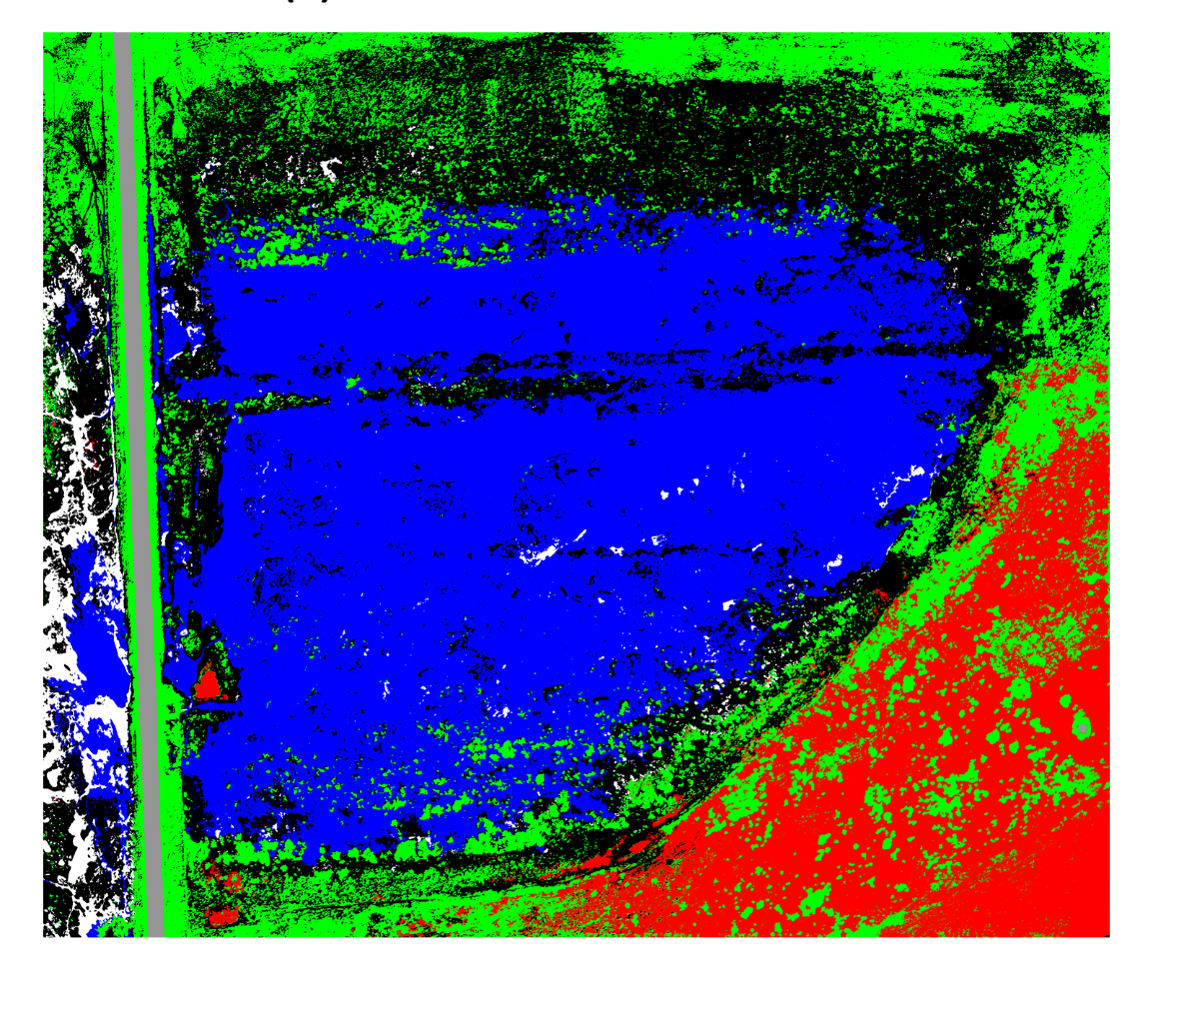
Data
Multispectral Imagery: 6 bands = Blue, Green, Red, Rededge, NIR + DSM (5123x8045x6)
RGB
Elevation
Ground Truth
GSD: 9.3 cm
GSD: 15.70 cm
Notes:
Discuss manual ground truth

Slide 4
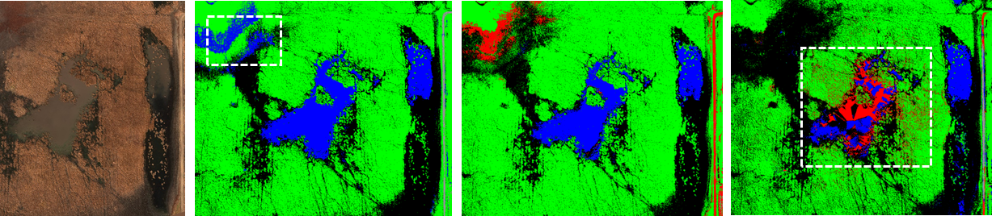
Data and Features
Multispectral Imagery: 6 bands = Blue, Green, Red, Rededge, NIR + DSM (5123x8045x6)
Dataset 1 (Train & Validation)
Dataset 2 (for test)
Feature 1: Multi-spectral Reflectance - Red (numeric 0-1)
Feature 2: Multi-spectral Reflectance - Blue (numeric 0-1)
Feature 3: Multi-spectral Reflectance - Green (numeric 0-1)
Feature 4: Multi-spectral Reflectance - NIR (numeric 0-1)
Feature 5: Multi-spectral Reflectance - Red Edge (numeric 0-1)
Feature 6: Elevation information - DSM (numeric by meter)
Dataset 1: 3559 / 50 million (03/08/2018)
Dataset 2: 10117830 / 50 million (03/01/2018)
Water ponding area
Notes:
Discuss manual ground truth

Slide 5
Workflow
Classification Problem
Segmentation
Preprocessing
Multispectral Data
Water
LSH residual
Soil
Ice
ESH residual
Vegetation cluster
K-mean
CNN-segmentation
Ensemble
Feature Normalizing
Feature selection
Blue
Green
Red
Red-edge
NIR
DSM
Metric: Accuracy & IoU
Y = W * X
Objective 1: Data preprocessing
Objective 2: K-means clustering
Objective 3: Using a single classifier and ensemble method to classify the image
Objective 4: Using a CNN-based semantic segmentation to conduct semantic segmentation over an image
Notes:
K Means
CNN Segmentation
Ensemble Classification Model

Slide 6
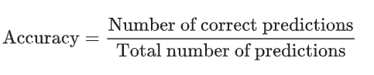
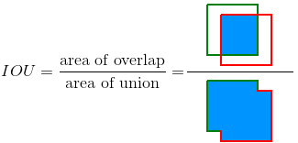
Metrics
Metrics
Accuracy: Accuracy is the ratio of correct predictions to the total number of predictions.
Intersection over Union (IoU): IoU is a metric that measures how similar our predicted boundary is to the ground truth boundary.
Prediction
Ground truth
Sources: https://supervise.ly/explore/plugins/mean-average-precision-m-ap-75277/overview

Slide 7
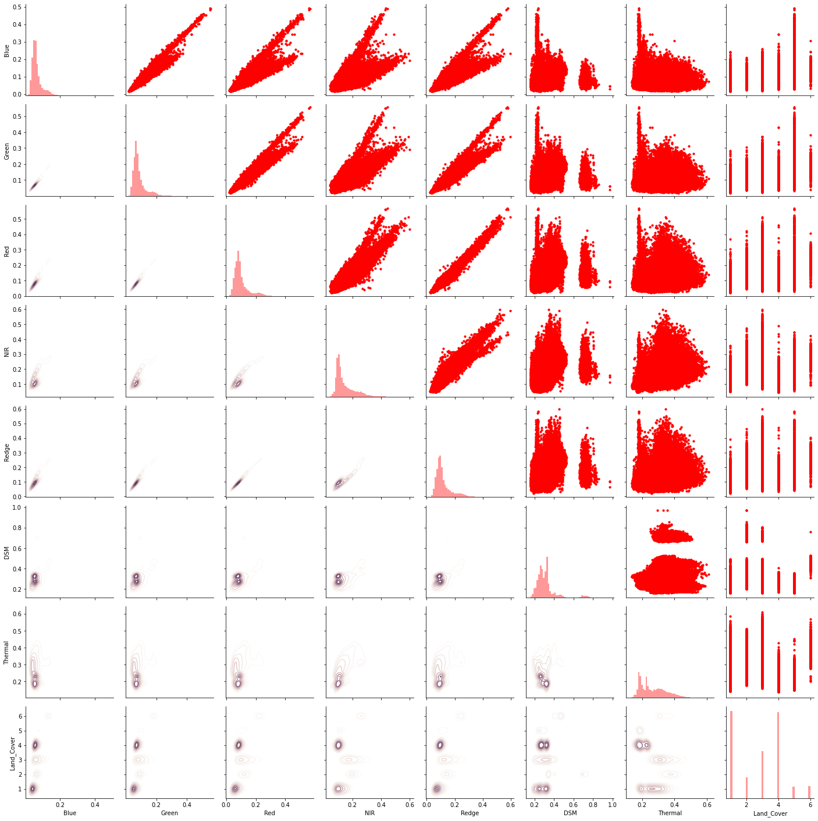
Preprocessing
Image Conversion
Six Identical resolution images loaded into memory and converted to single numerical value
Entries with six features and X vs Y coordinates
Each feature Z score normalized with a normal distribution
PCA Considered but not deemed necessary
Blue Green Red NIR Red-edge DSM Land cover
Blue Green Red NIR Red-edge DSM Land cover

Slide 8
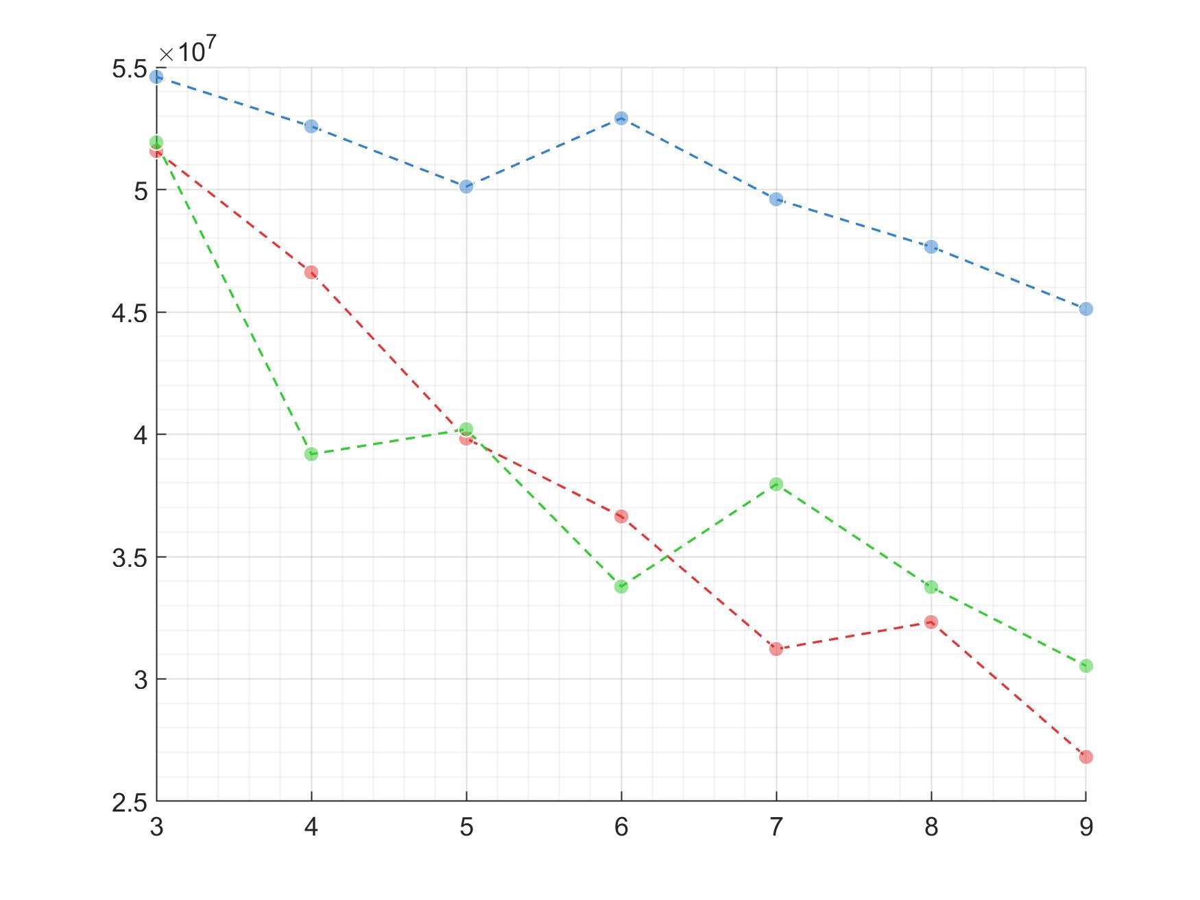
K-means
VRC ratio
Ratio of between-cluster variance to within-cluster variance
Higher ratios indicate better clustering operation
Elbow point indicate optimal clustering
Feature 1:3
Variance ratio criterion (VRC)
Feature 1:6
Feature 1:5
Clustering with 5-7 clusters show good VRC performance, so we choose 6 to conduct our clustering operation later.
Cluster Numbers

Slide 9
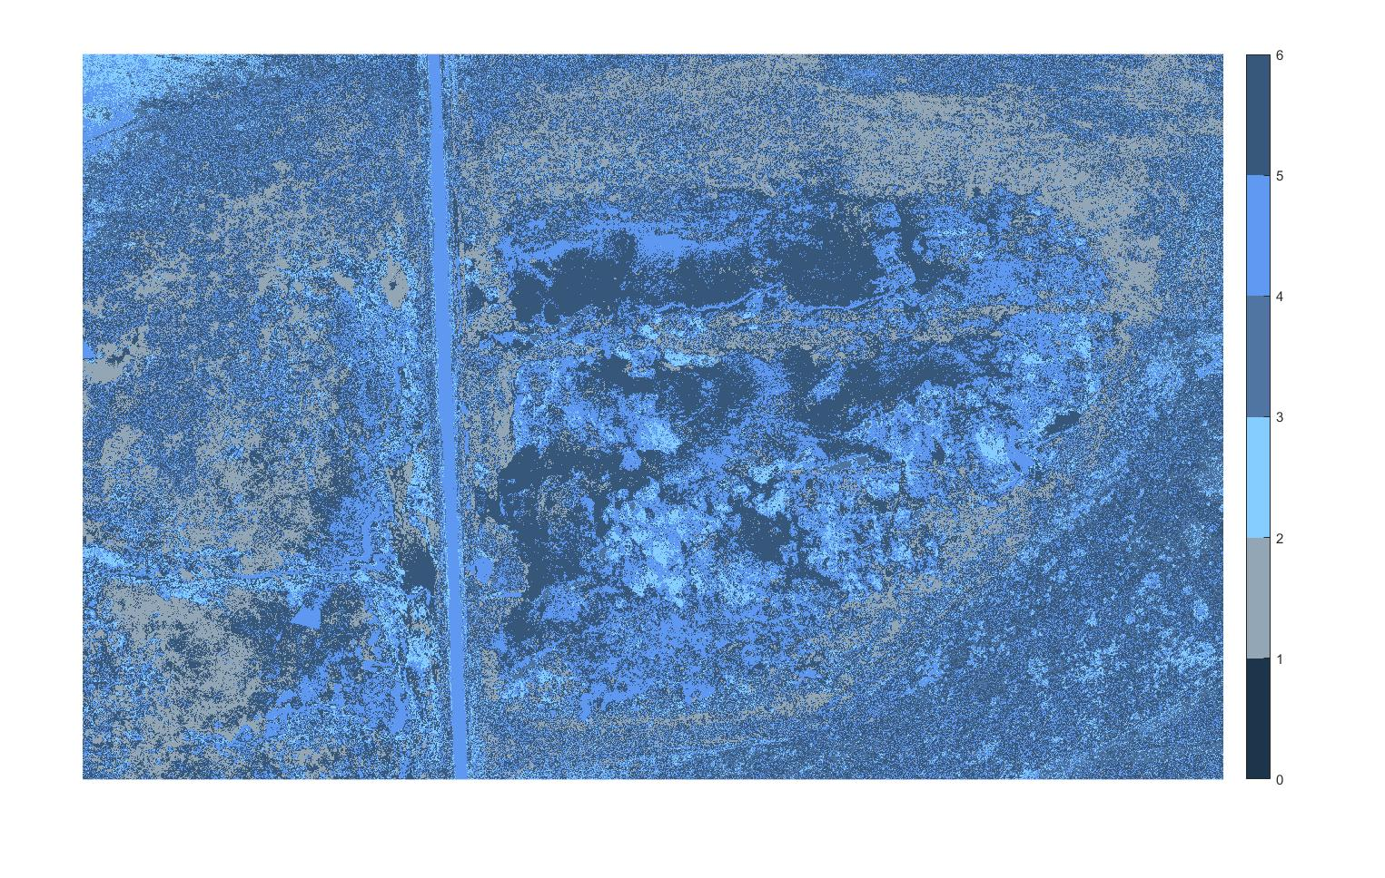
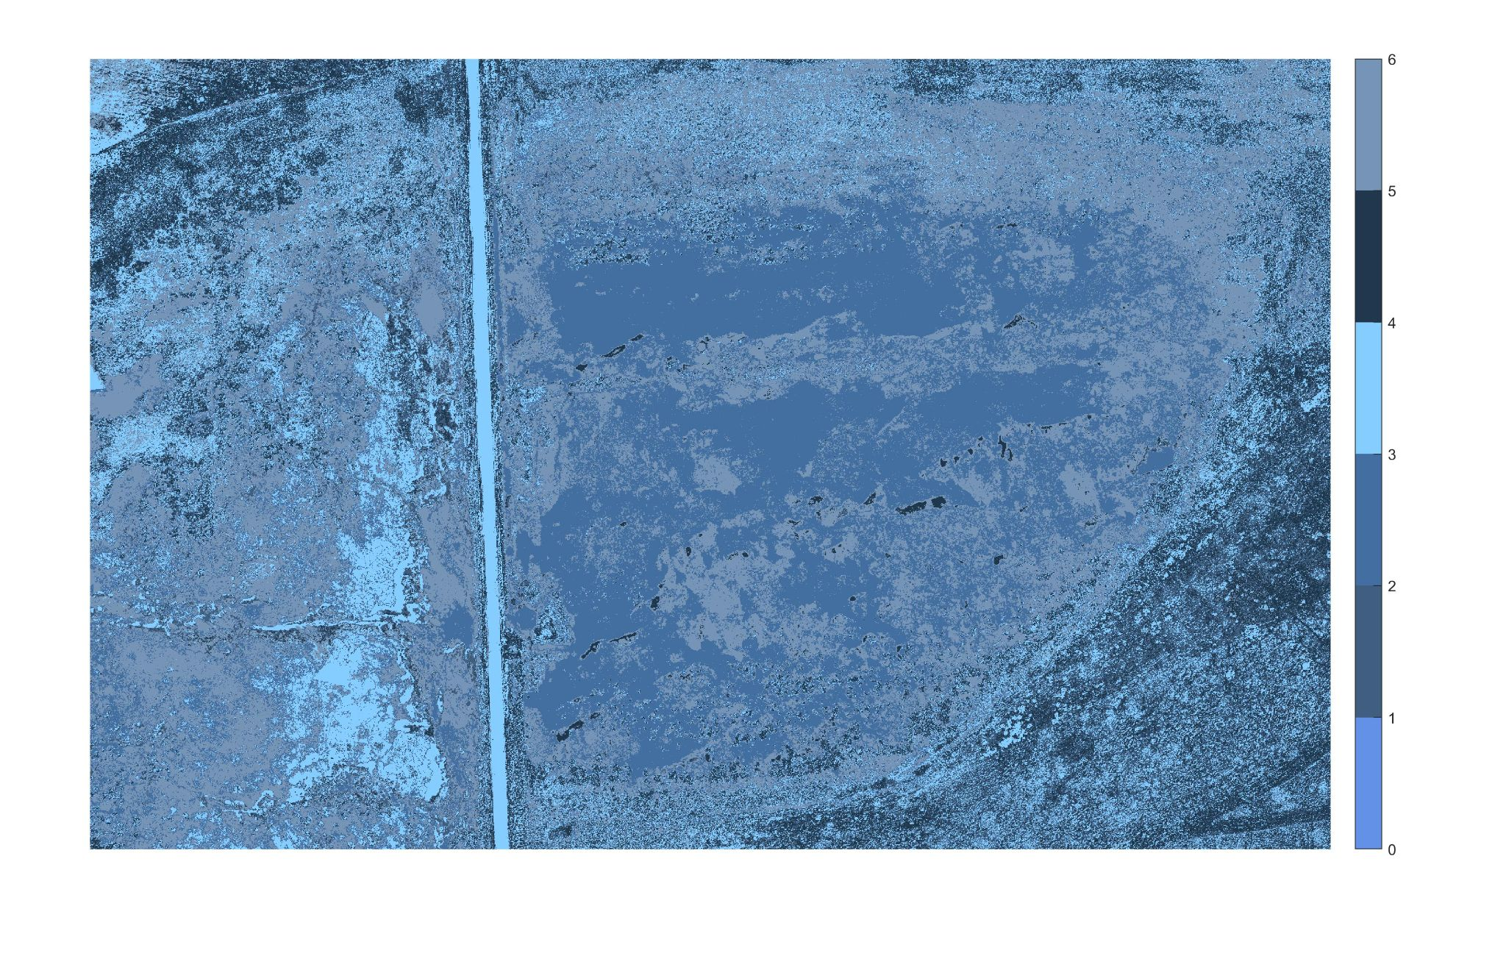
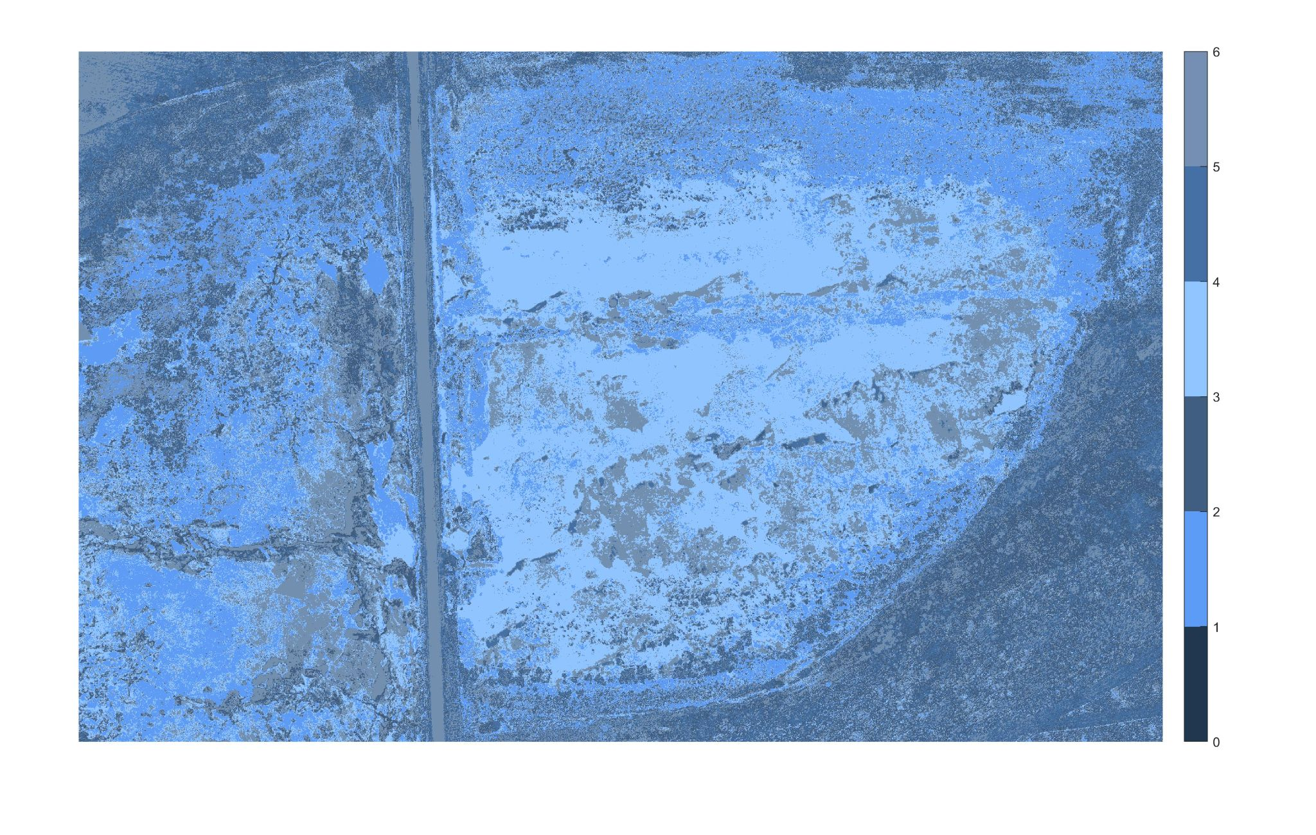
K-means
Feature 1:3
Feature 1:5
Feature 1:6
Visually, adding NIR and red-edge band (Feature 1:5) and elevation (Feature 1:5) enhance the clustering cohesion.
But it is hard to connect the unsupervised cluster to the really groundtruth directly.
We select the result of feature 1:6 for later accuracy test as it return the best clustering performance visually.

Slide 10
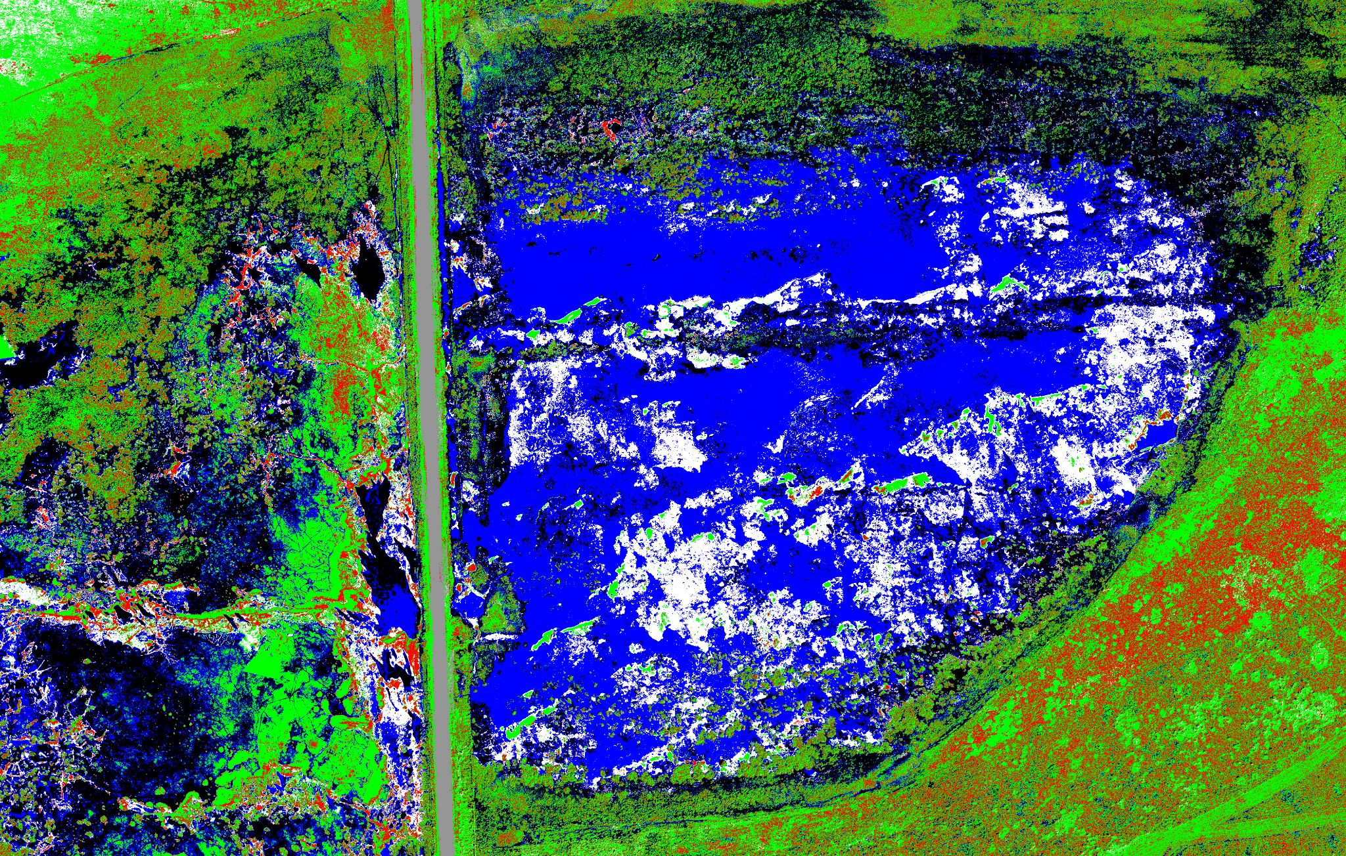
K-means
Results from Feature 1:6 with 6 clusters
Category |  | Band 1:6
Class | Label | Accuracy | IoU
Soil | 1 | 61.2% | 57.3%
ESH Residual | 2 | 46.8% | 35.7%
LSH Residual | 3 | 77.8% | 47.7%
Water | 4 | 70.9% | 60.8%
Ice | 5 | 25.7% | 0.04%
Road | 6 | 91.1% | 80.0%
Global | - | 65.9% | 60.0%
We select the k-mean results from feature 1:6 and manually assign the closest label to each cluster.
Accuracy of each class was measured.

Slide 11
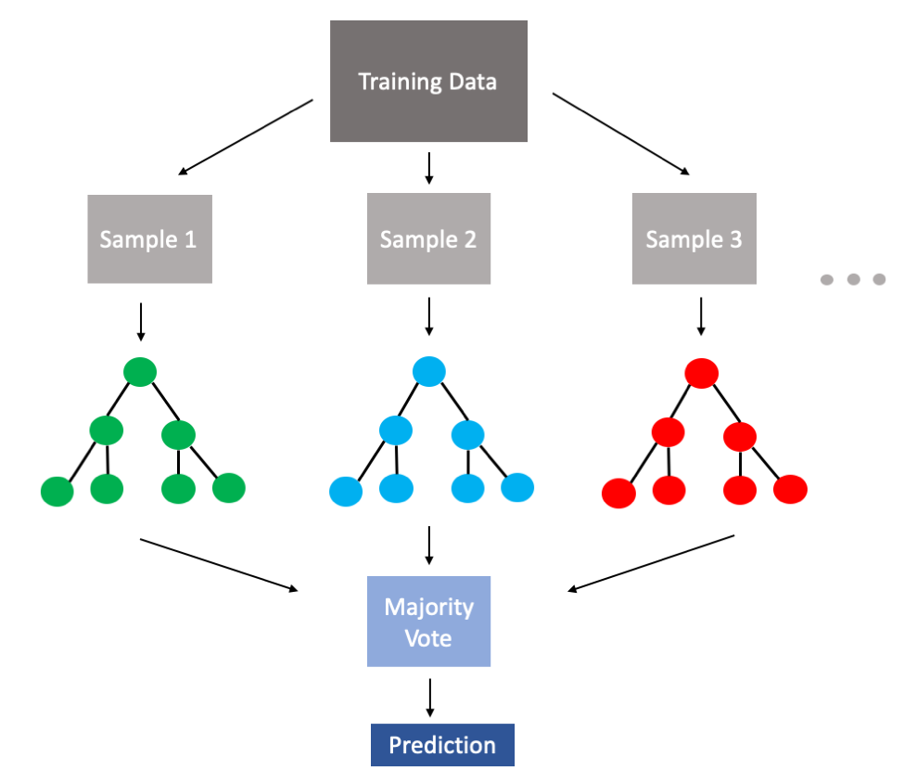
Ensemble Method: Bagging Classifier
Decision Tree Bagging Classifier
Comparison of single decision tree with bagging classifier.
Bagging: sampling with replacement and training on multiple decision trees.
Prediction made based on majority vote.
Trained on 20% of the total data set (random pixels).
Implemented in Scikit Learn [1].

Slide 12
Ensemble Method: Bagging Classifier for Site 1
Results
Category |  | Band 1:3 |  | Band 1:5 |  | Band 1:6
Class | Label | DT Accuracy | Bag Accuracy | DT Accuracy | Bag Accuracy | DT Accuracy | Bag Accuracy
Soil | 1 | 80.4% | 84.0% | 86.0% | 89.2% | 88.2% | 90.1%
ESH Residual | 2 | 48.6% | 38.3% | 55.9% | 52.1% | 88.2% | 91.2%
LSH Residual | 3 | 67.4% | 66.1% | 72.2% | 71.3% | 84.2% | 83.0%
Water | 4 | 82.1% | 84.8% | 93.2% | 94.0% | 94.5% | 94.8%
Ice | 5 | 77.0% | 79.3% | 79.8% | 80.3% | 82.8% | 82.0%
Road | 6 | 80.0% | 79.8% | 91.6% | 92.1% | 95.7% | 95.2%
Global | - | 74.7% | 75.4% | 81.7% | 82.5% | 89.0% | 90.0%
 | Band 1:3 |  | Band 1:5 |  | Band 1:6
 | DT | Bag | DT | Bag | DT | Bag
Training Runtime (seconds) | 185.5 | 171.25 | 264.58 | 258.19 | 304.94 | 312.16
Full band feature set resulted in best performance overall.
Bagging classifier results in marginal increase in performance in each case (≈ 1%).
ESH Residual highly sensitive to inclusion of DSM (band 6).
Water not sensitive to DSM; high accuracy from bands 1:5.

Slide 13
Ensemble Method: Bagging Classifier
Results
Confusion Matrix
Class | Label | Soil | ESH Residual | LSH Residual | Water | Ice | Road
Soil | 1 | 12,982,044 | 35,024 | 748,042 | 421,658 | 84,459 | 14
ESH Residual | 2 | 49,048 | 3,599,014 | 297,269 | 102 | 1,187 | 1,353
LSH Residual | 3 | 1,116,981 | 452,944 | 8,043,637 | 40,391 | 33,527 | 12,842
Water | 4 | 493,806 | 74 | 43,283 | 10,917,645 | 54,993 | 24
Ice | 5 | 118,370 | 335 | 37,923 | 76,052 | 1,066,777 | 33
Road | 6 | 14 | 3,988 | 19,142 | 232 | 63 | 462,245
LSH Residual, Water, and Ice were most often misclassified as Soil.
Soil, ESH Residual, and Road were most often misclassified as LSH Residual.
Road had lowest rate of misclassification and also lowest representation in the data set.

Slide 14
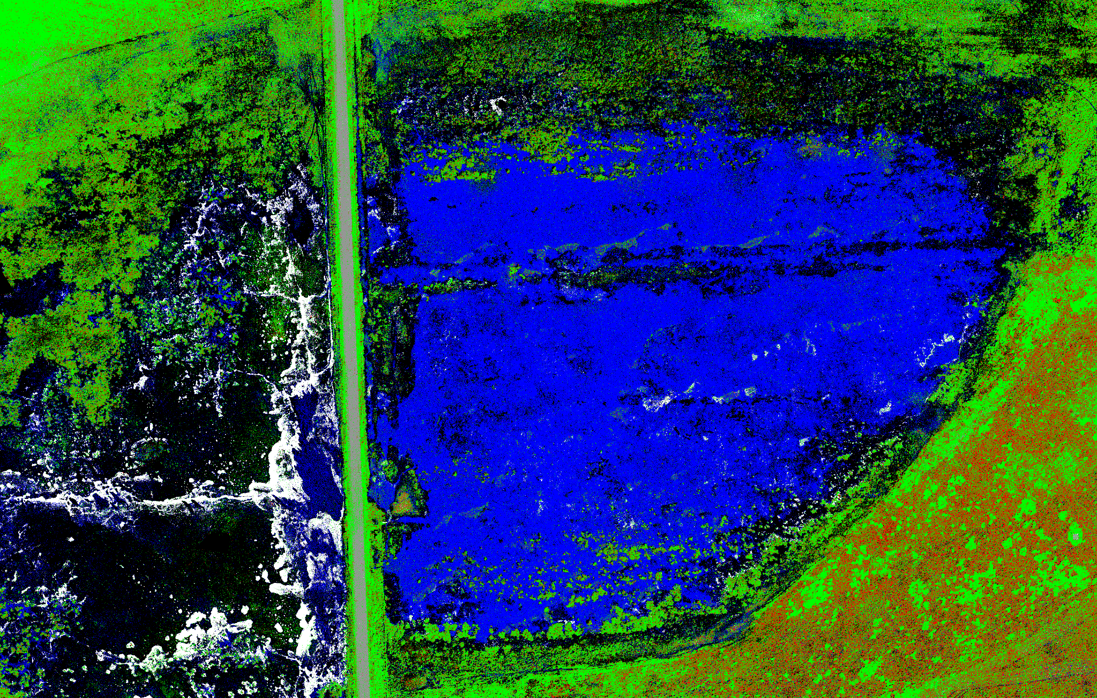
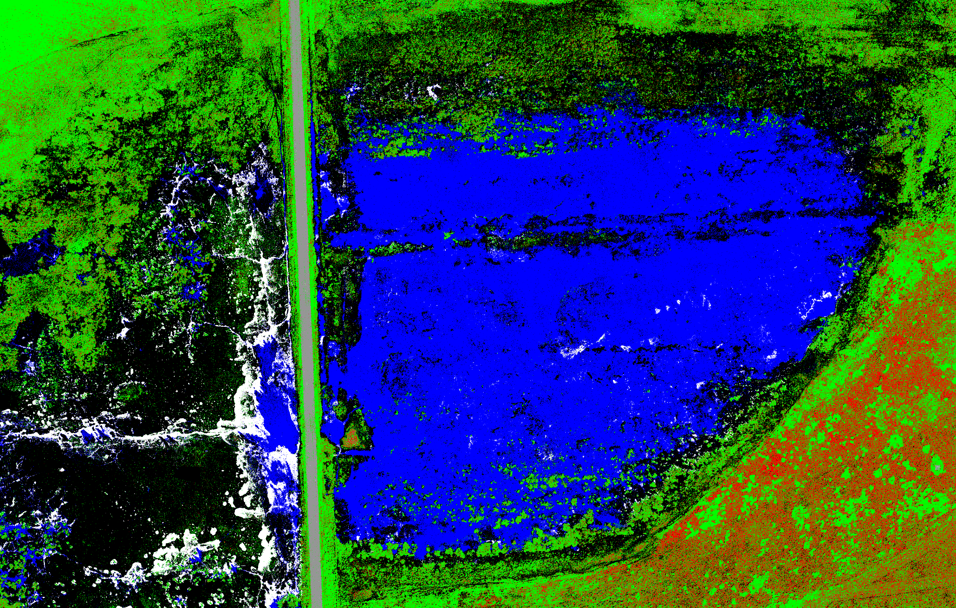
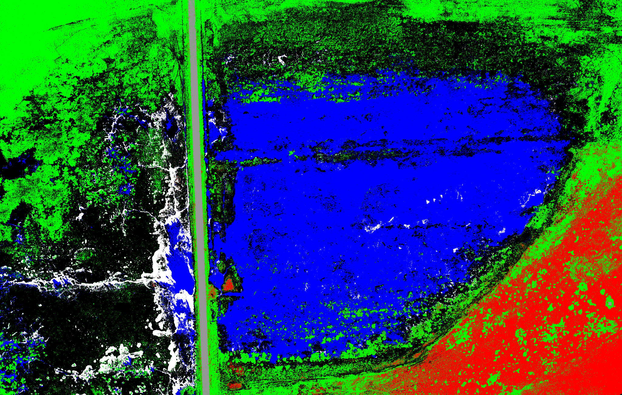
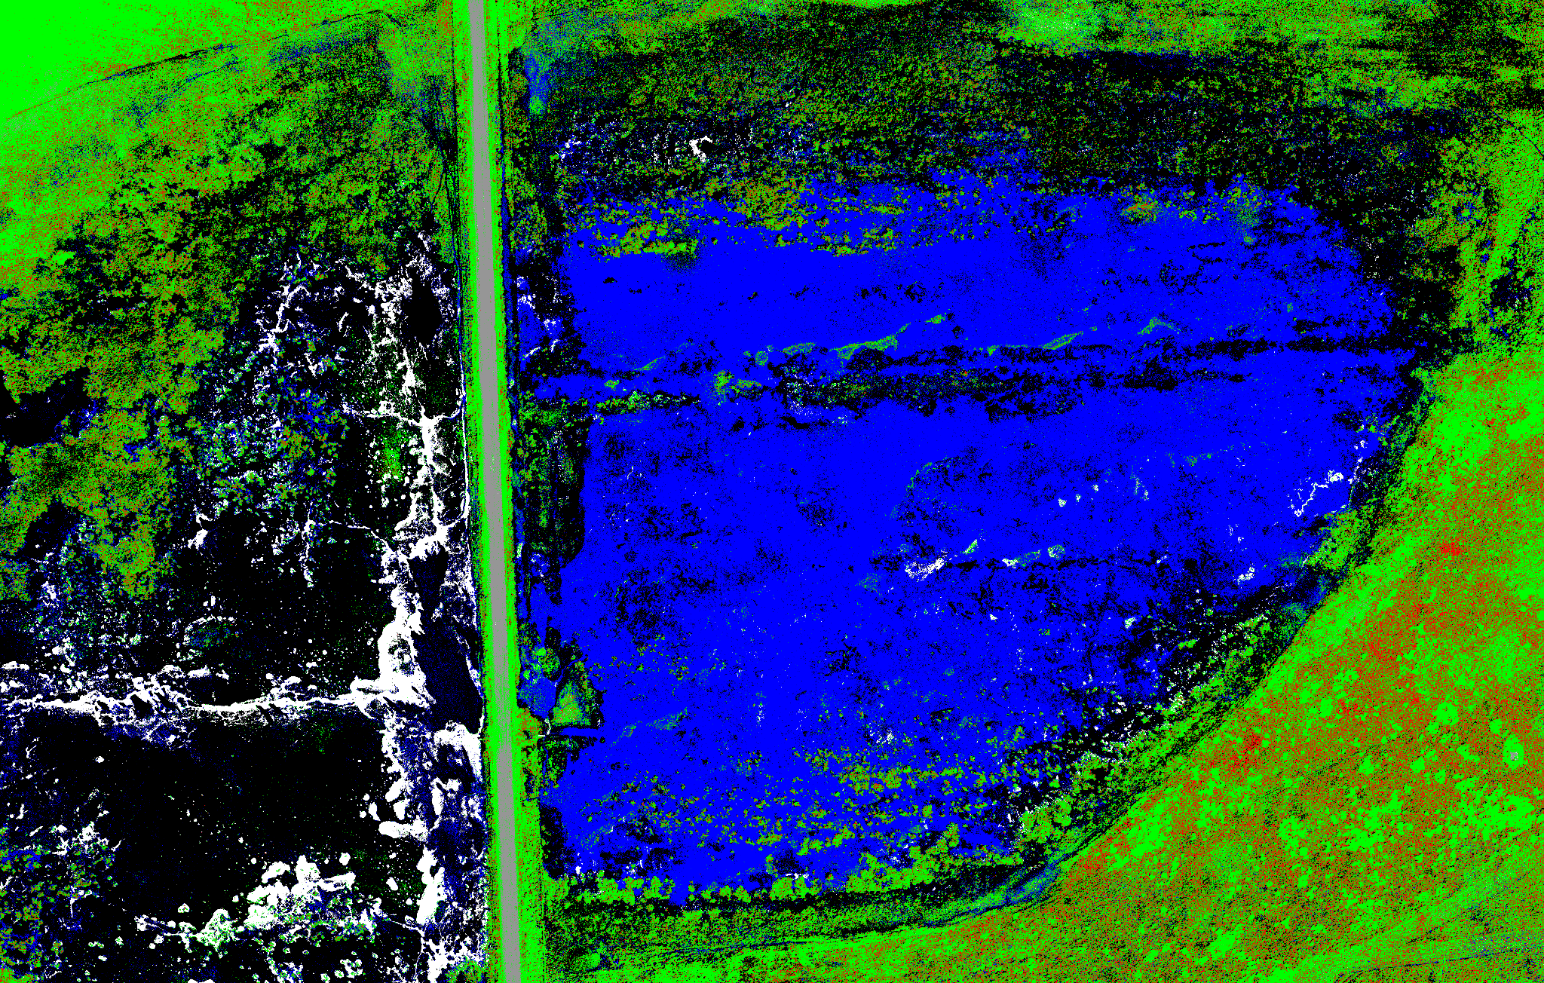
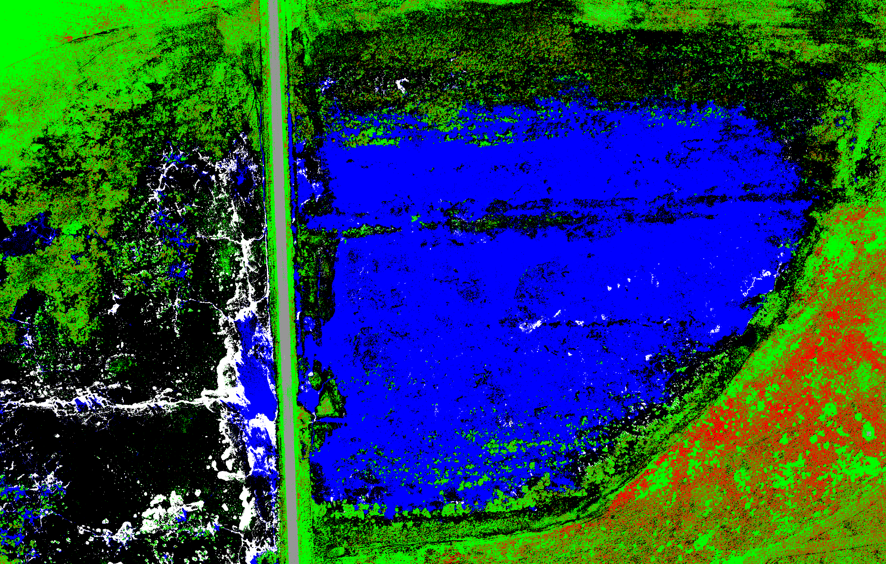
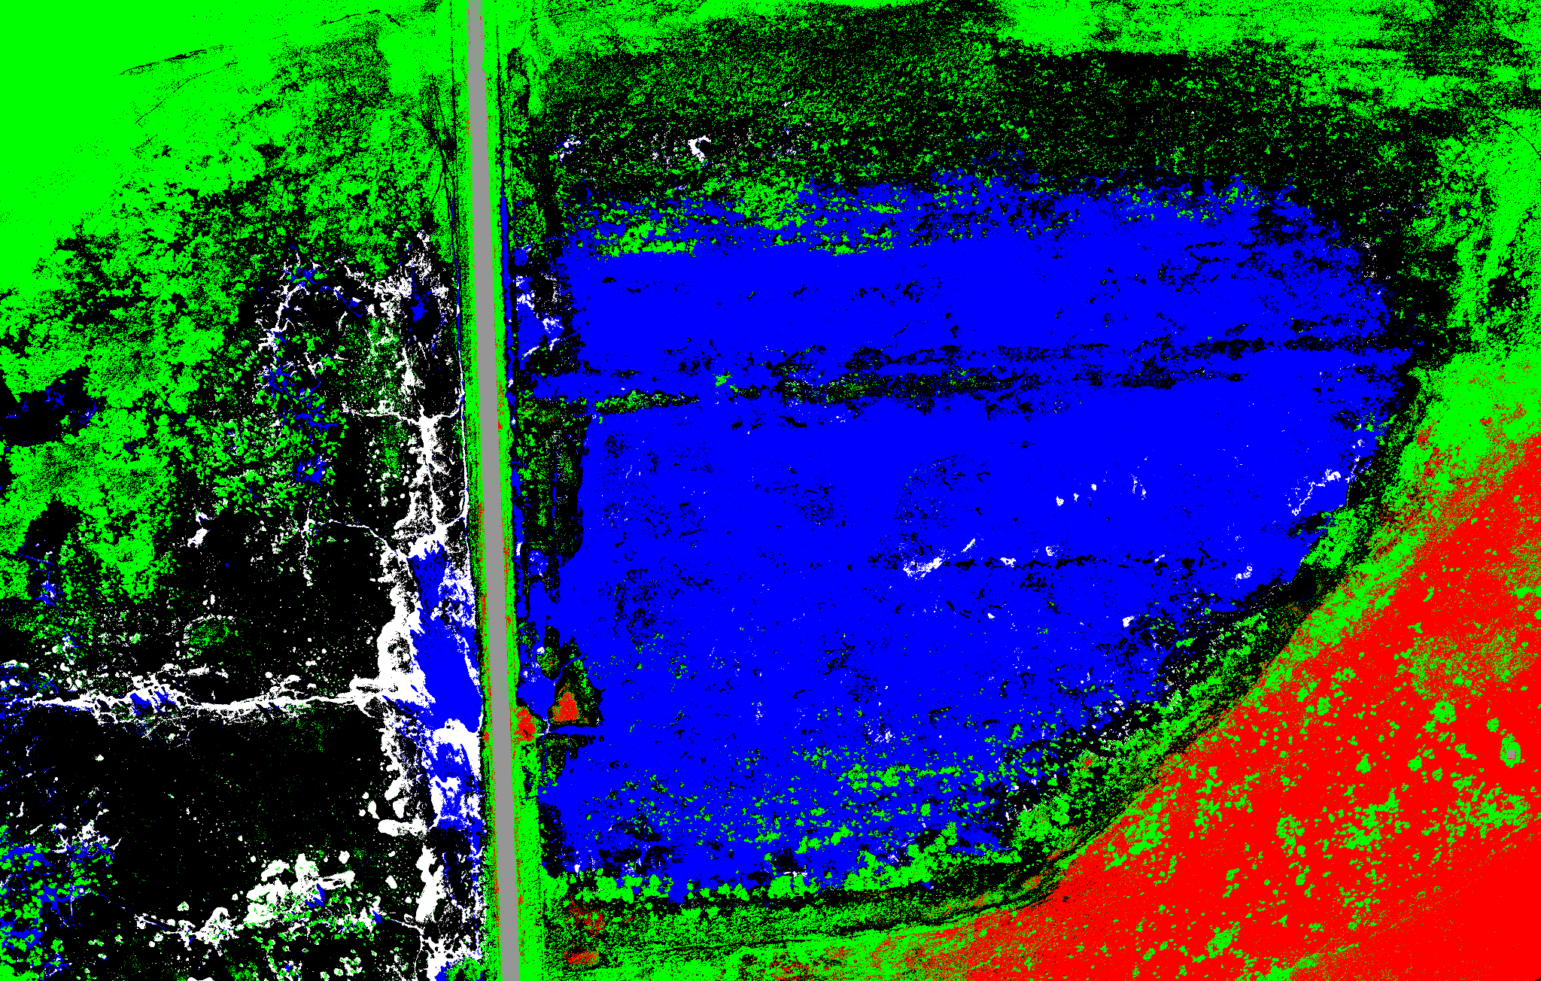
Ensemble Method: Bagging Classifier for Site 1
Band 1:3
Band 1:5
Band 1:6
Decision Tree
Bagging Classifier

Slide 15
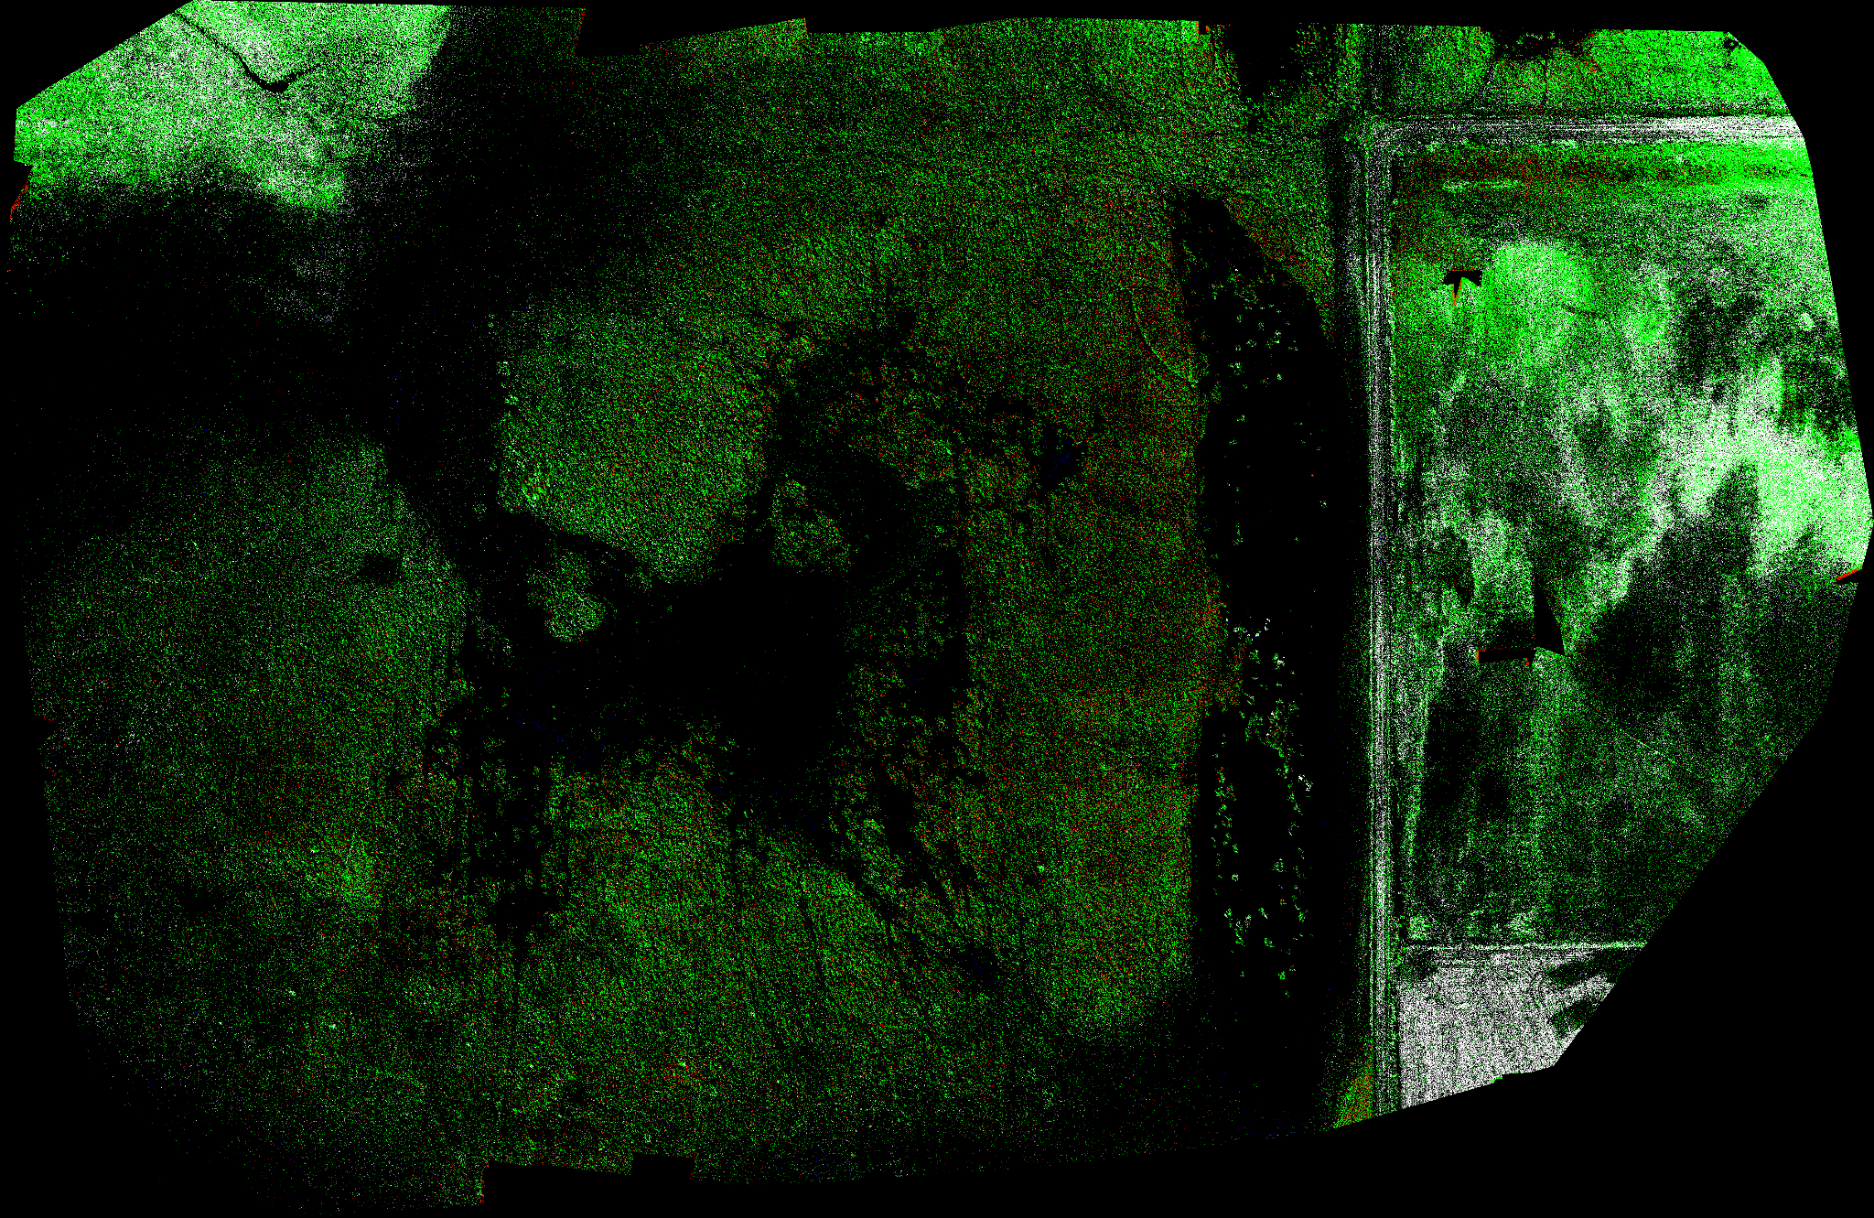
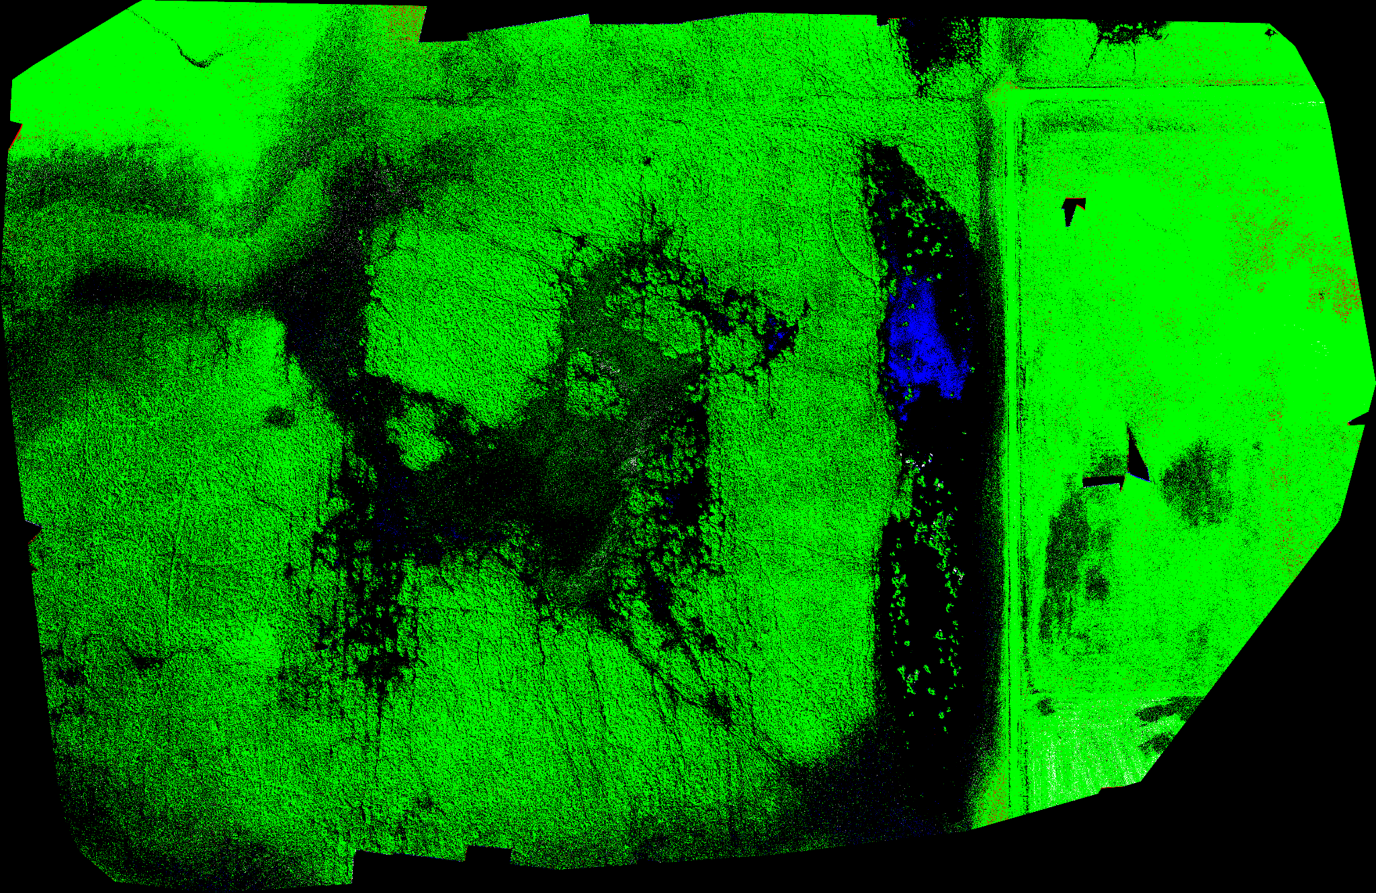
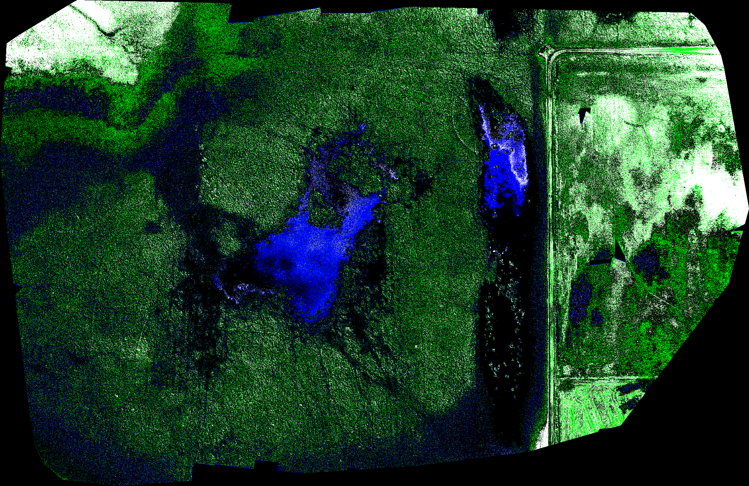
Ensemble Method: Bagging Classifier for Test
RGB Reference
Band 1:3
Band 1:5
Band 1:6
RGB bands are insufficient alone to provide classification of varying land covers.
Adding DSM improves the classification, especially with respect to water.

Slide 16
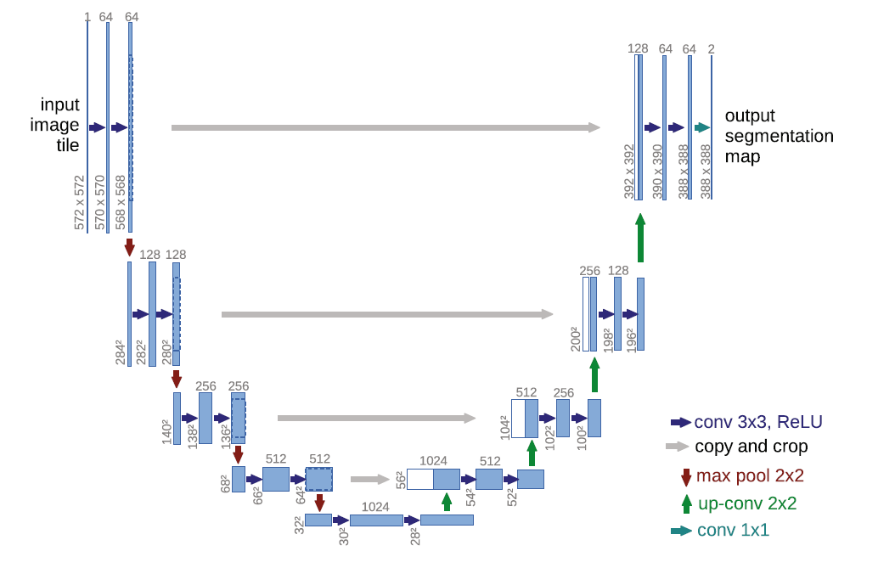
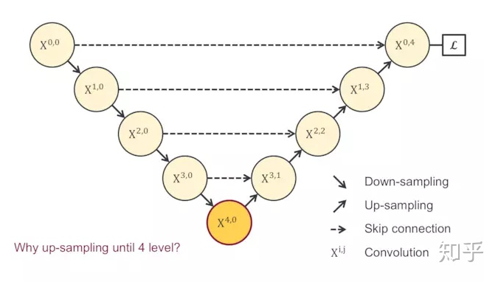
Semantic Segmentation: U-net Architecture
Key characteristics
Encoder-decoder CNN architecture
Skip connection
Multi-scale spatial features
Input & output
Given image with shape of (m,n,c)
Produce label with shape of (m,n,1)
Cross entropy loss
encoder
decoder
skip connection

Slide 17

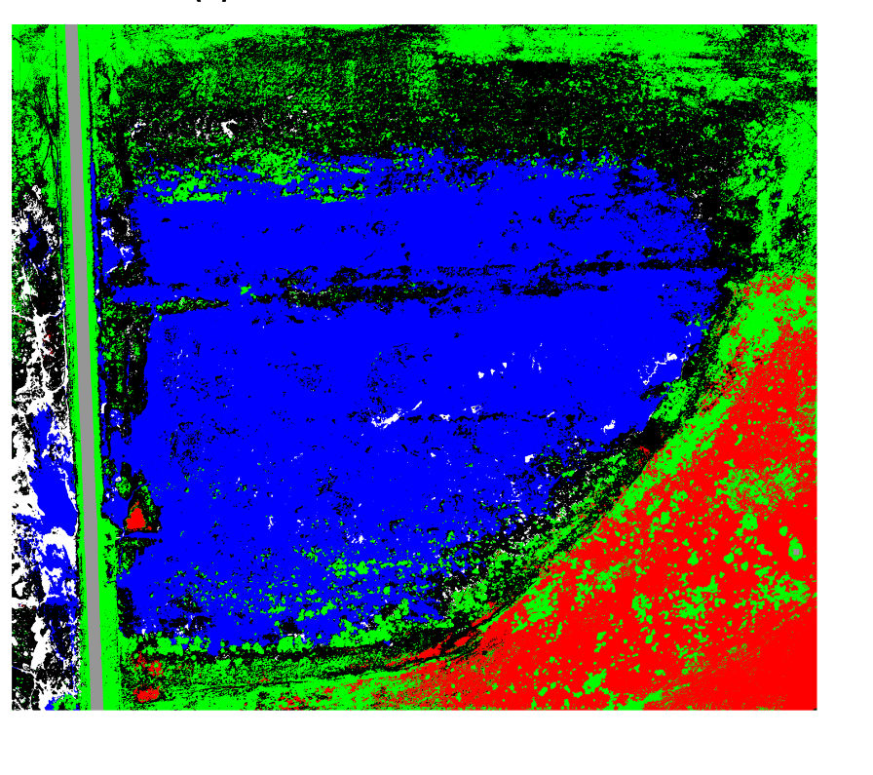
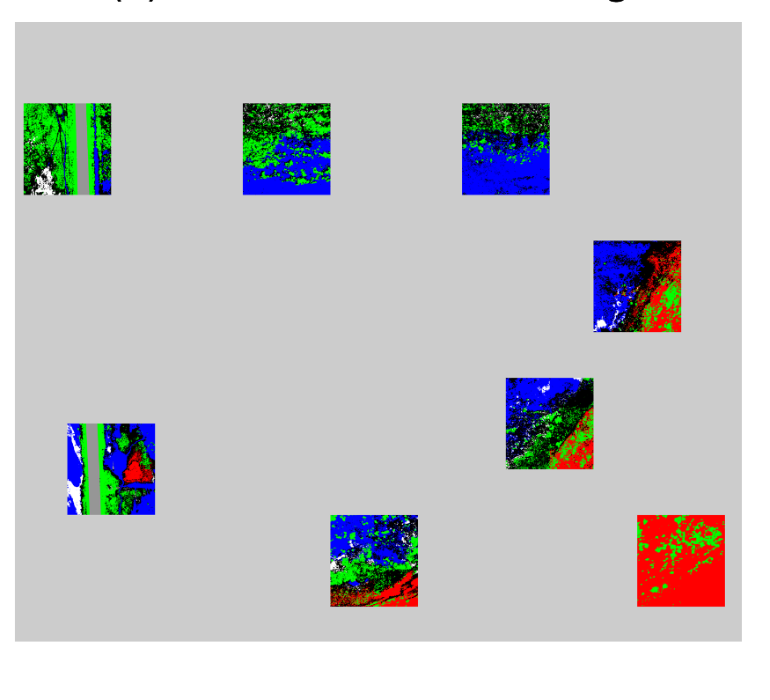
Semantic Segmentation: U-net Training
RGB reference Ground truth Sample region
Sample region: 8
Training sample shape: 256x256x6
Training sample number: 1600
Data augmentation: reflection, translation and rotation

Slide 18
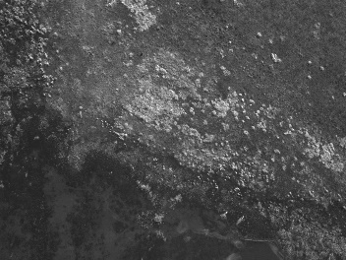
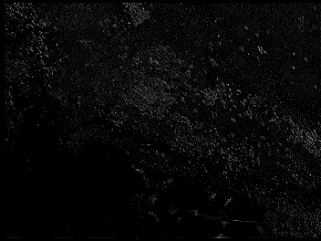
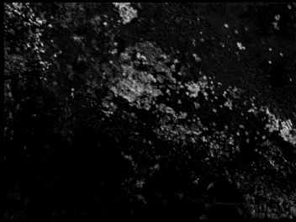
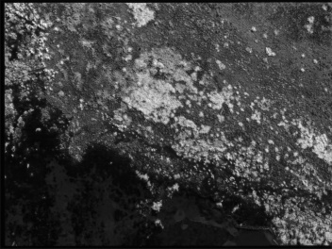
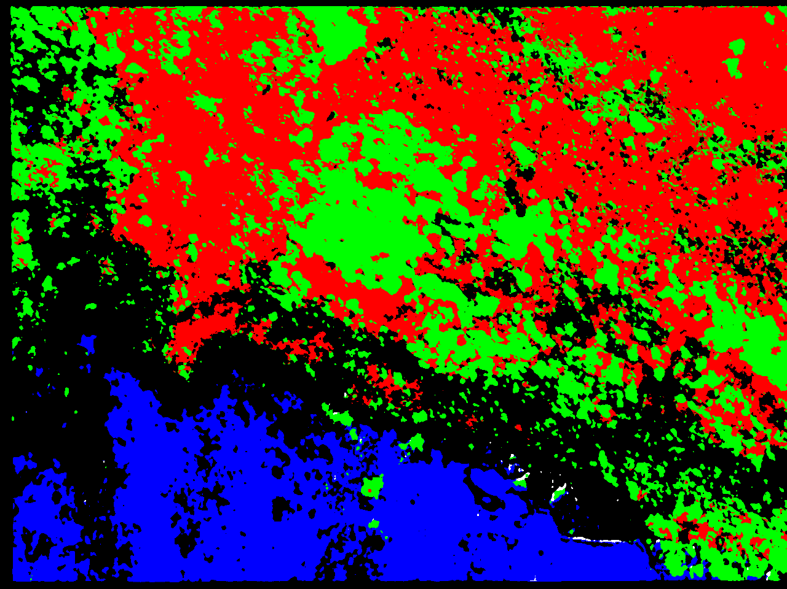
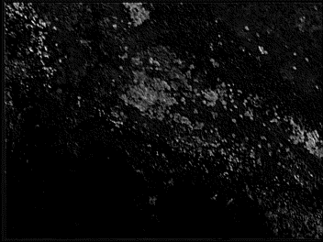
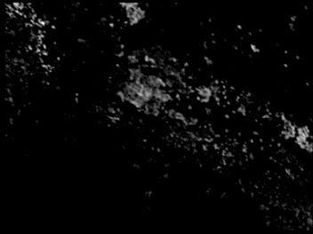
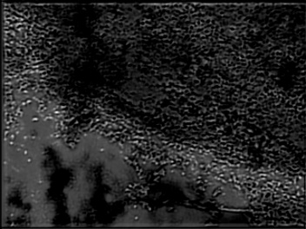
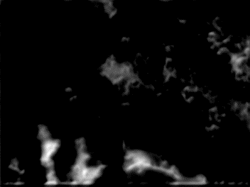
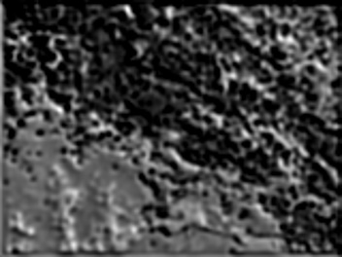
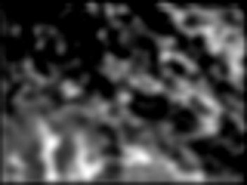
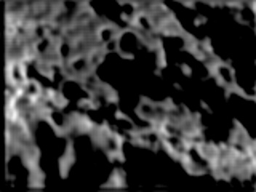
Semantic Segmentation: U-net Feature Flow
Input
Encoder
Decoder
Output
Classification
(256,256,64)
(256,256,-)
(256,256,6)
(256,256,1)
(128,128,128)
Learning rate: 0.0001
Epoch: 20
(64,64,256)
encoder
decoder
skip connection
(32,32,512)
(16,16,1024)

Slide 19
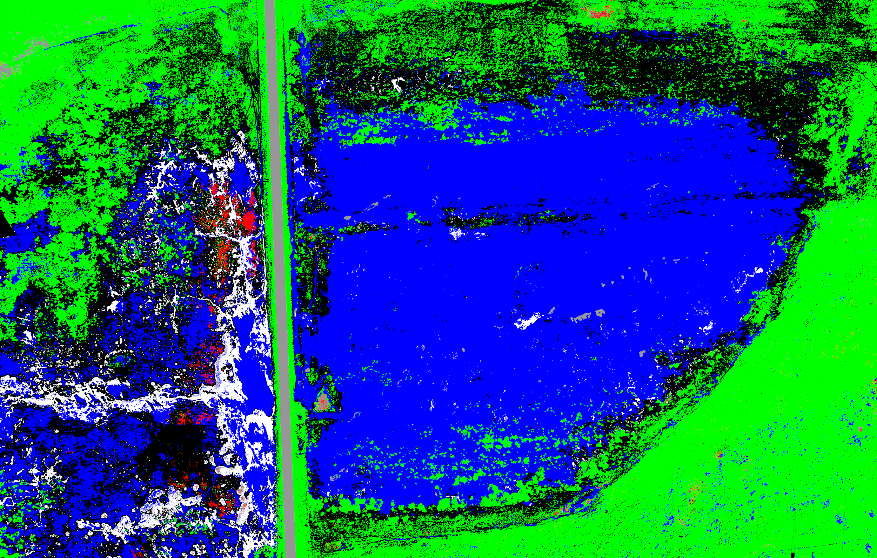
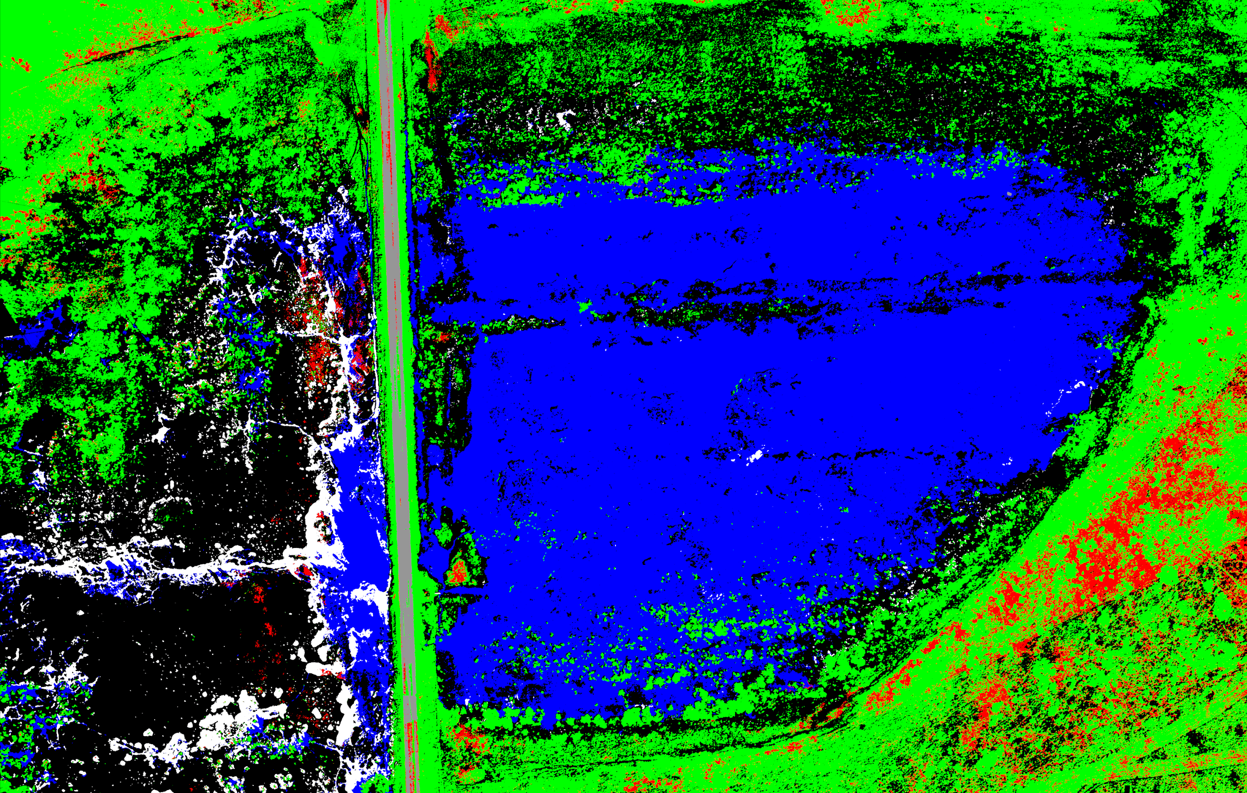
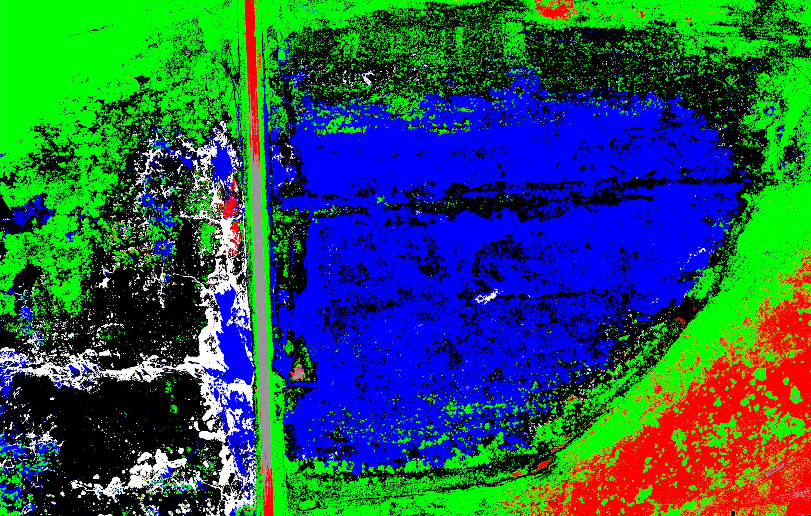
Semantic Segmentation Results for Site 1: U-Net
Feature 1:3 Feature 1:5 Feature 1:6

Slide 20
Semantic Segmentation Results for Site 1
Category |  | Band 1:3 |  | Band 1:5 |  | Band 1:6
Class | Label | Accuracy | IoU | Accuracy | IoU | Accuracy | IoU
Soil | 1 | 73.1% | 67.8% | 95.0% | 75.0% | 61.2% | 59.5%
ESH Residual | 2 | 0.4% | 0.4% | 55.4% | 47.1% | 71.2% | 69.3%
LSH Residual | 3 | 89.0% | 51.8% | 69.5% | 56.6% | 93.3% | 70.5%
Water | 4 | 99.1% | 83.9% | 95.4% | 93.4% | 99.5% | 80.6%
Ice | 5 | 74.2% | 69.4% | 89.0% | 65.6% | 60.0% | 59.3%
Road | 6 | 98.1% | 86.9% | 51.0% | 50.7% | 96.5% | 95.0%
Global | - | 72.3% | 60.0% | 86.2% | 67.3% | 83.7% | 80.3%
Generally, full band return significantly higher performance than three bands.
Adding DSM band enhance the boundary matchness of the segmented land cover.

Slide 21
Semantic Segmentation Results for Site 2
RGB reference Feature 1:3 Feature 1:5 Feature 1:6
Adding NIR and rededge band enhance the classification performance.
Adding DSM band decrease the performance of the land cover classification.
CNN-semantic segmentation have better generalization than division tree.

Slide 22
Conclusion
Key points
This study used multispectral UAV wetland image data to conduct a pixel level semantic segmentation task.
K-means clustering returned weaker performance in terms of both accuracy and efficiency (labor investment required)
Ensemble Decision Tree performed well with 90% overall accuracy and relatively fast training runtime ( < 6 minutes in all cases) but have potential overfitting issue.
Results showed CNN semantic segmentation effectively learn the spatial patterns and generalize well on different datasets.
The study proved the potential of using data mining/machine learning method to automate the land cover classification task, enhancing the efficiency and accuracy, assisting future wetland delineation and management.
Pros & Cons
Kmean is efficient but additional human inspection have to be engaged
CNN-based semantic segmentation training is time consuming, computing intensive during training (10h with 2 RTX 2060 GPU)
Ensemble decision tree offer cost-effective approach for the delineation task
Future perspective
Improving the model robustness by collecting data from a wider range of experiments
Utilized PCA or other advanced feature selection approaches to preprocessing the data for potential efficiency and accuracy gain

Slide 23
Cited Works
[1] A. A. Bishop and M. V. Vrtiska, “Effects of the wetlands reserve program on waterfowl carrying capacity in the Rainwater Basin region of south-central Nebraska,” Nat. Resour. Conserv. Serv. Conserv. Eff. Assess., vol. 39, no. 2, p. 51, 2008.
[2] C. L. Zweig, M. A. Burgess, H. F. Percival, and W. M. Kitchens, “Use of unmanned aircraft systems to delineate fine-scale wetland vegetation communities,” Wetlands, vol. 35, no. 2, pp. 303–309, 2015
[3] O. Mutanga, E. Adam, and M. A. Cho, “High density biomass estimation for wetland vegetation using worldview-2 imagery and random forest regression algorithm,” Int. J. Appl. Earth Obs. Geoinf., vol. 18, no. 1, pp. 399–406, 2012.
[4] A. L. Long, K. M. Kettenring, C. P. Hawkins, and C. M. U. Neale, “Distribution and Drivers of a Widespread, Invasive Wetland Grass, Phragmites australis, in Wetlands of the Great Salt Lake, Utah, USA,” Wetlands, vol. 37, no. 1, pp. 45–57, 2017.
[5] M. Mahdianpari, B. Salehi, F. Mohammadimanesh, and M. Motagh, “Random forest wetland classification using ALOS-2 L-band, RADARSAT-2 C-band, and TerraSAR-X imagery,” ISPRS J. Photogramm. Remote Sens., vol. 130, pp. 13–31, 2017.
[6] T. Liu and A. Abd-Elrahman, “Multi-view object-based classification of wetland land covers using unmanned aircraft system images,” Remote Sens. Environ., vol. 216, no. June, pp. 122–138, 2018.
[7] T. Liu and A. Abd-Elrahman, “An object-based image analysis method for enhancing classification of land covers using fully convolutional networks and multi-view images of small Unmanned Aerial System,” Remote Sens., vol. 10, no. 3, 2018.
[8] T. Liu, A. Abd-Elrahman, A. Zare, B. A. Dewitt, L. Flory, and S. E. Smith, “A fully learnable context-driven object-based model for mapping land cover using multi-view data from unmanned aircraft systems,” Remote Sens. Environ., vol. 216, no. July, pp. 328–344, 2018.
[9] F. Pedregosa, G. Varoquaux, A. Gramfort, V. Michel, B. Thirion, O. Grisel, M. Blondel, P. Prettenhofer, R. Weiss, V. Dubourg, J. Van-derplas, A. Passos, D. Cournapeau, M. Brucher, M. Perrot, and E. Duchesnay, “Scikit-learn: Machine learning in Python,” Journal of Machine Learning Research, vol. 12, pp. 2825-2830, 2011
[10] F. Pedregosa, G. Varoquaux, A. Gramfort, V. Michel, B. Thirion, O. Grisel, M. Blondel, P. Prettenhofer, R. Weiss, V. Dubourg, J. Van-derplas, A. Passos, D. Cournapeau, M. Brucher, M. Perrot, and E. Duchesnay, “Scikit-learn: Machine learning in Python,” Journal of Machine Learning Research, vol. 12, pp. 2825-2830, 2011

Slide 24
Thanks!

